Slide 1

ishuttle
KODAH INC with dinho productions.

Slide 2
CONTENT
Introduction
Is it worth it?
Model Specification

Slide 3
Introduction
The iShuttle app is an app designed to track the current location of shuttles on campus
The iShuttle app would also be able to give an estimate of the time the next shuttle would arrive.
The iShuttle app would be developed for android users since from our surveys it carried a larger percentage

Slide 4
Is it worth it?
Our target group were the students on KNUST campus so we conducted a survey on the relevance of our app and how it would help them make life and “marks” saving decisions.
We used google forms to create a questionnaire and take down peoples responses
Our responses are in the following slides.

Slide 5

Is it worth it?

Slide 6
Is it worth it?

Slide 7
Is it worth it?

Slide 8
Is it worth it?

Slide 9
Is it worth it?

Slide 10
Features of the app
Track location of the bus in real time.
Give the estimated time of arrival of bus to your current shuttle terminal.
Log in/Sign Up page
Driver Interface
Student Interface
Backend:Java
Frontend:Java

Slide 11

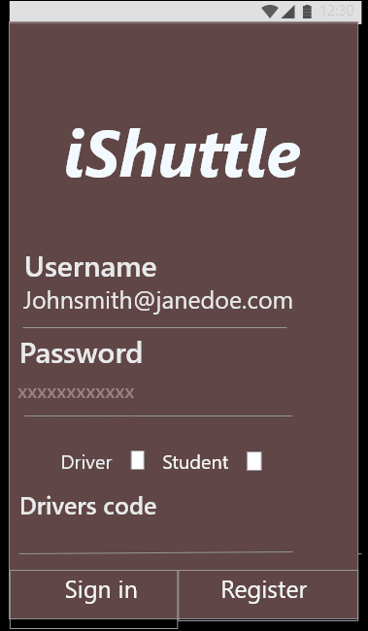
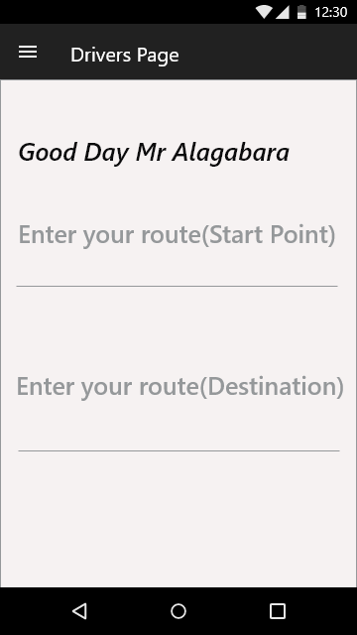
Prototype( SIGN IN PROCESS FOR DRIVER)

Slide 12
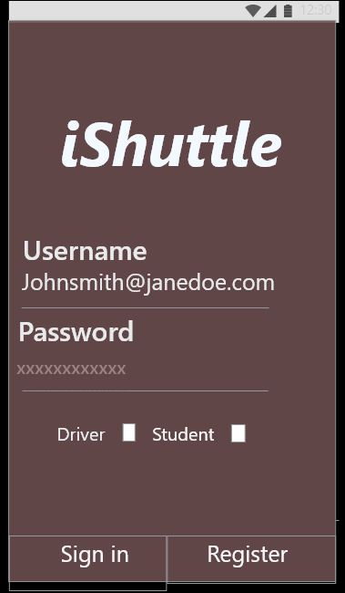
Prototype( SIGN IN PROCESS For Users )

Slide 13

Any questions?
THANK YOU.

